Slide 1


Slide 2
Kowloon in 24 Hours
Rhea Nayyar, Adhar Sharma, Hoi Ying Li (Bonnie)

Slide 3
Why visit Kowloon?
Popular spots for local people (adults, young people, the elderly…) to hang around
Local businesses
Tourist-friendly
A combination of urban life style and culture
Great local cuisine

Slide 4
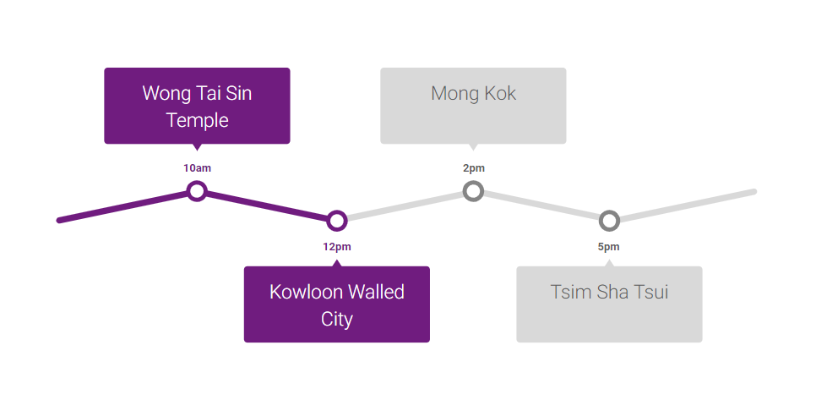

Slide 5
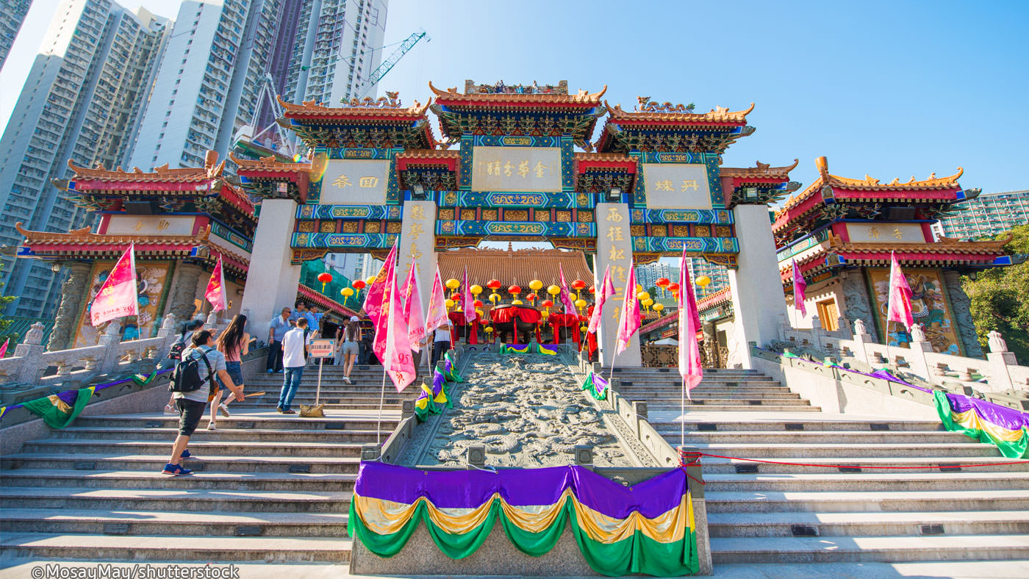
Wong Tai Sin

Slide 6
Why visit the Wong Tai Sin Temple?
Religious beliefs - Home to three religions (Taoism, Confucianism, Buddhism)
Feng Shui enthusiasts may notice structures representing the five geomantic elements: the Bronze Pavilion (metal); the Archives Hall (wood); the Yuk Yik Fountain (water); the Yue Heung Shrine (fire), where the Buddha of the Lighting Lamp is worshipped; and the Earth Wall (earth). Other areas of the complex include the Three Saints Hall, the Confucian Hall and the extravagantly colorful Good Wish Garden that is lavishly decorated with chinoiserie.

Slide 7
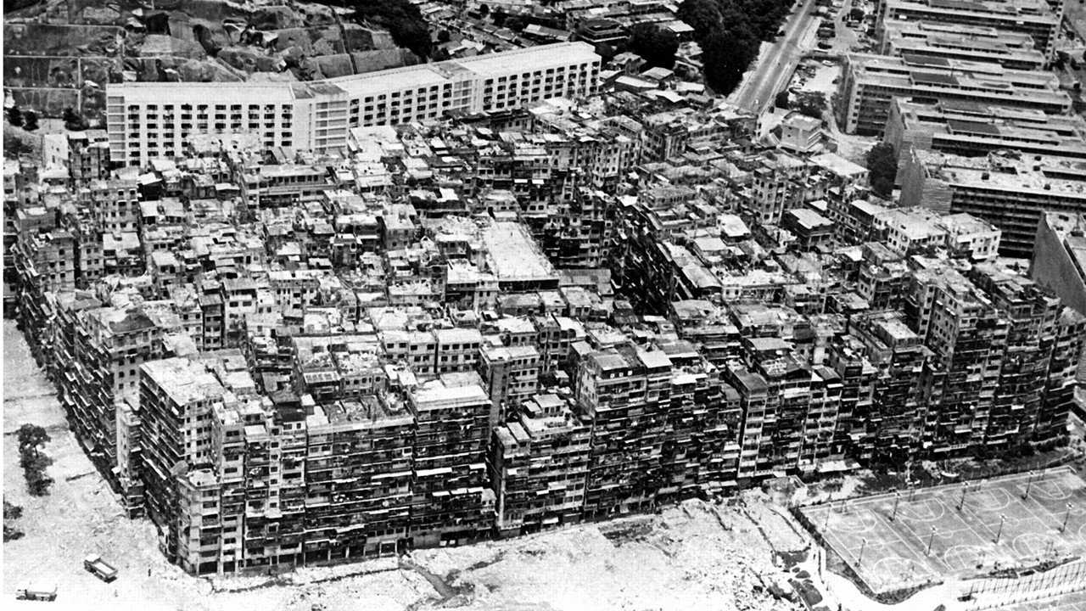
Kowloon Walled City

Slide 8
Why visit the Kowloon Walled City?
Kowloon Walled City Park sits on the very site of the former Kowloon Walled City, remembered today as a haven of crime and debauchery.
The site occupies a strategic point along the Kowloon peninsula and has been used by Chinese imperial officials since the 16th century. In 1841, when Hong Kong Island was ceded to Britain, Kowloon Walled City was already a garrison and was reinforced by the Chinese Government. The fort’s fate changed in 1898 when the New Territories were leased to Britain for 99 years. Although the walled city remained Chinese territory by treaty, the following year their troops and officials were forced to vacate. Behind them they left a power vacuum that was filled by criminals, and the garrison became a city within a city.
In 1987, with the agreement of China, the colonial government finally took control of the no-go area, resettled its inhabitants, and replaced the slum with a park. Today, the Chinese-style park preserves traces of the walled city, most notably its yamen, the imperial government administrative building. The Jiangnan garden–style of the park also offers visitors a chance to appreciate the beauty of nature in a place where the darker side of human nature once flourished.

Slide 9
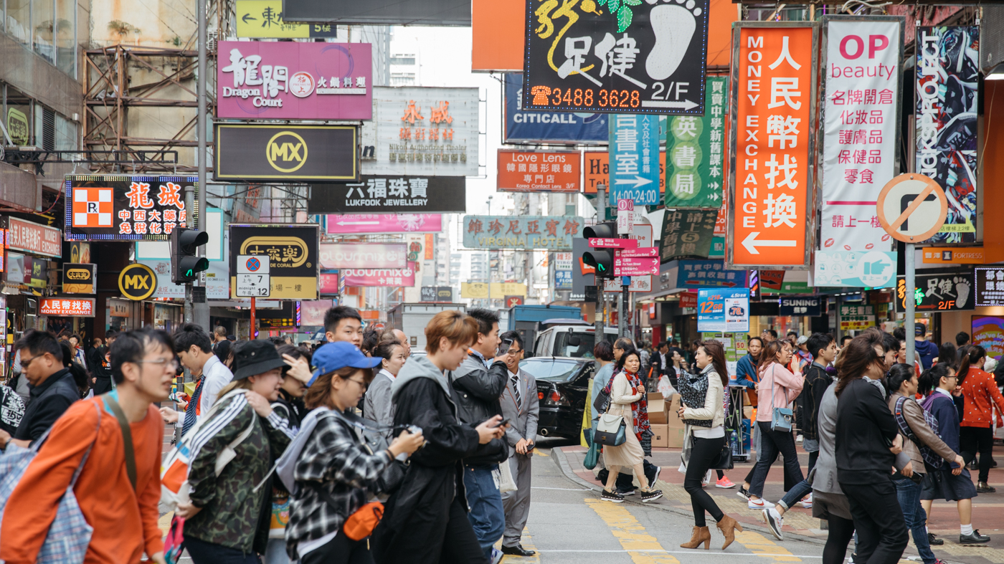
Mong Kok

Slide 10
Why visit Mong Kok?
Mong Kok is Hong Kong’s most congested shopping and residential district, but don’t let that scare you away. The neon-bathed historic streets that wind through one of the densest parts of the world are worth visiting - just for the ‘peoplescapes’ alone. It just so happens that the shopping is excellent too.
The neighbourhood includes one of Hong Kong’s most popular markets, the Ladies' Market, and also has a ton of shopping streets, which are a common feature in southern China. Conveniently, these are where a cluster of merchants sell one type of product on a single street. Mong Kok has entire streets and street sections dedicated to the sale of goldfish, flowers, birds, sneakers, and kitchenware.

Slide 11
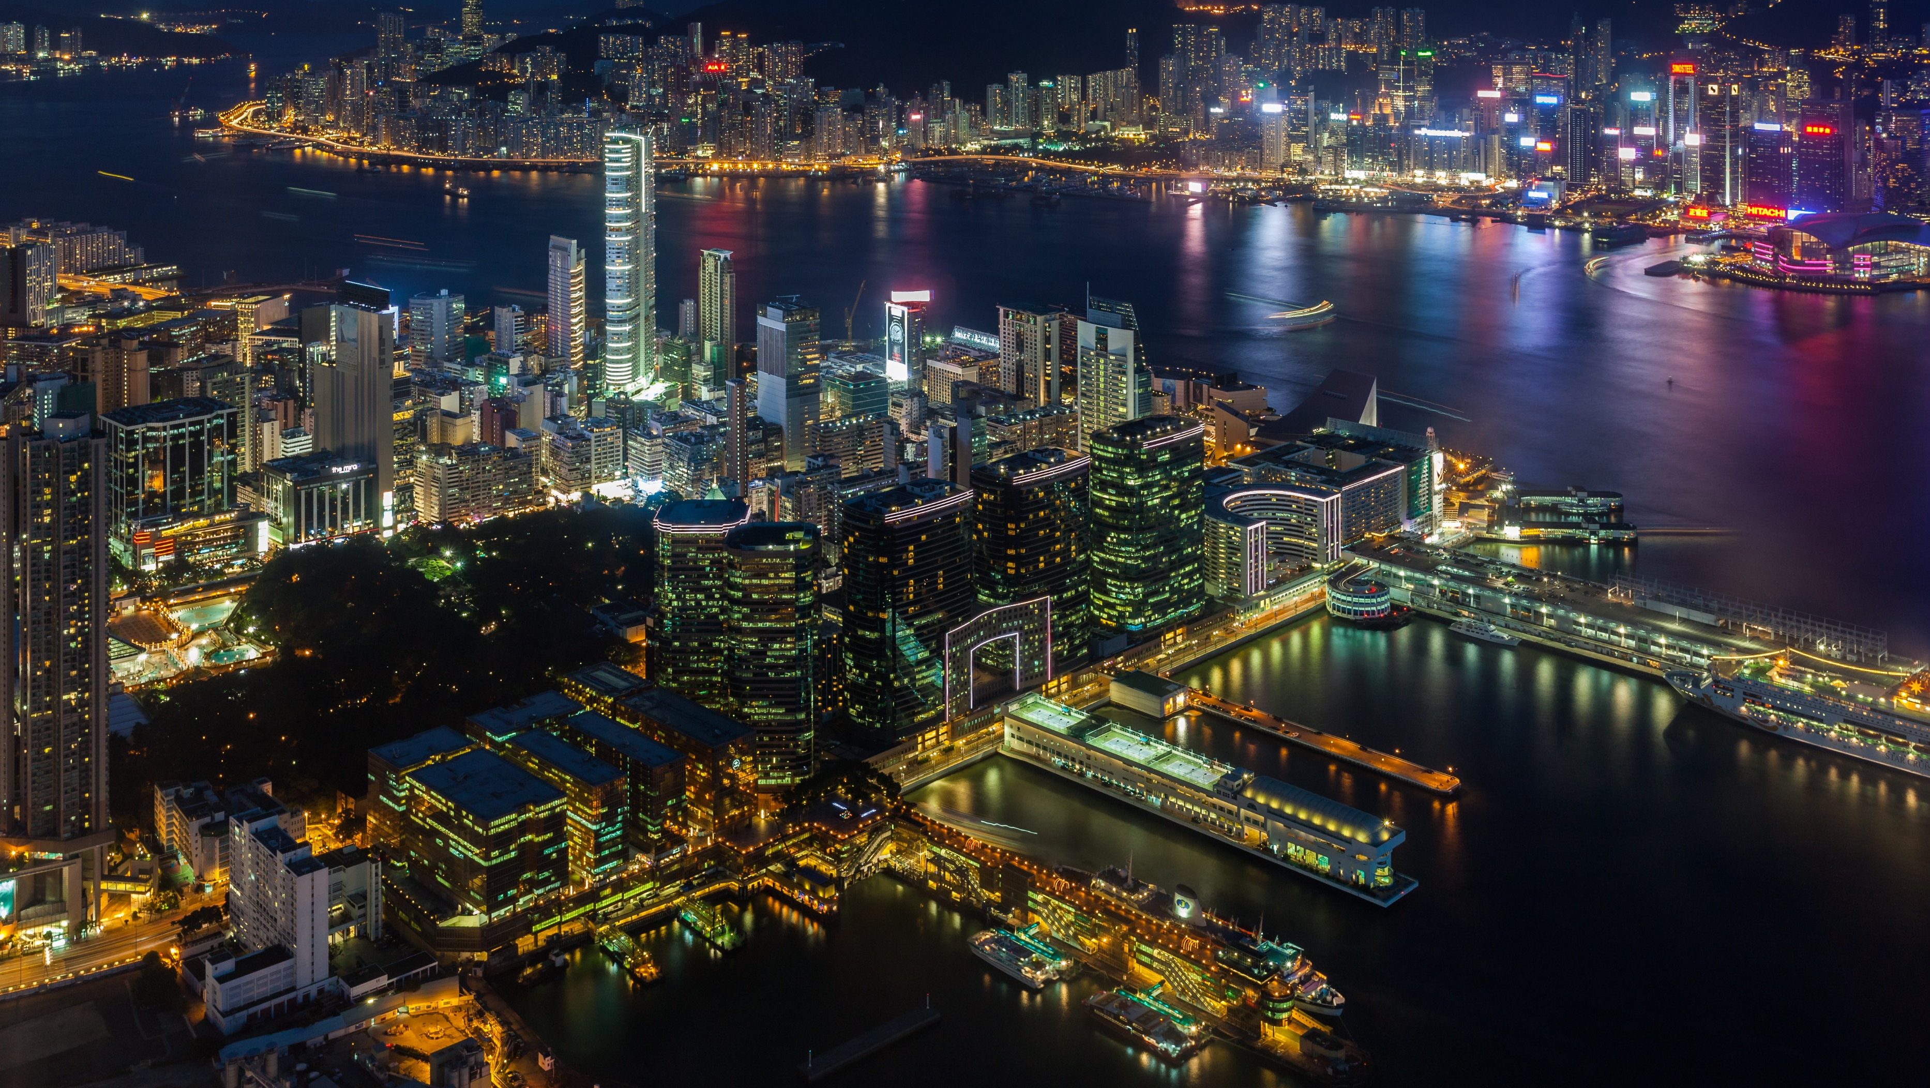
Tsim Sha Tsui
Tsim Sha Tsui

Slide 12
Why visit Tsim Sha Tsui?
Tsim Sha Tsui is one of the most important and bustling districts of Hong Kong. It’s where you can find large shopping malls, a ferry pier, lively and vibrant streets, galleries, and a variety of restaurants. Tourists can spend a busy and culturally stimulating day enjoying what the district has to offer as there’s plenty of scenic spots, here’s our selection of the best.
If you want to have a relaxing walk in Tsim Sha Tsui, Kowloon Park is the perfect place for you. It’s where you can surround yourself with an abundance of plants and greenery, and take part in numerous activities, such as swimming, bird watching, and football. The area was originally the Whitfield Barracks, a military area for the British Army. In 1970, it became Kowloon Park, complete with 13.3 hectares (33 acres) of space, making it one of the best parks in Hong Kong.
Tsim Sha Tsui Ferry Pier, also known as the Star Ferry Pier, is one of the most important landmarks in the district. The star ferries have been carrying passengers from Kowloon to Hong Kong Island since the 1880s. Although many new road and rail systems have been established, people still love taking the ferry as it allows passengers to take an up-close look at the stunning harbor, which is a significant aspect of Hong Kong culture.

